Slide 1
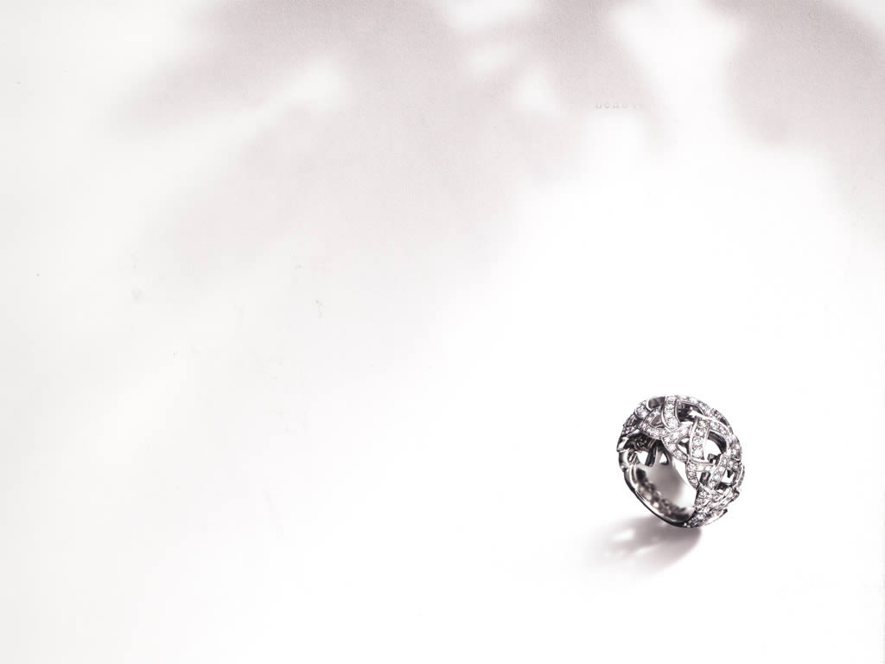
What influences diamond price?
---statistics analysis of factors and price
By: Chen Xie, Jie Li, Lishangyan Cai

Slide 2
Motivation
Nowadays, many people purchase diamonds as the necessity of their weddings. And diamond also becomes one of the most popular fashion decorations among youth. Which brings us the concern about what the key elements influence diamond price are.
In this project, our group is going to use SAS tool to make a statistic analysis of influential factors for diamond price.

Slide 3
Sample and Dataset
We will use the dataset for 308 round-cut diamonds, taken from a Singapore newspaper ad. For each of the diamonds, the data included its weight, color, clarity and price in Singapore dollars. For convenience, we have transferred the prices to American dollars.
This dataset was collected by the Journal of Statistics Education data archive.

Slide 4
The Factors (Explanatory variables)
Weight
in carat
quantitative variable: continuous
Color
Grade (highest to lowest): D, E, F, G, H, I
ordinal
Clarity
GIA Scale (best to worst): IF, VS1, VS2, VVS1, VVS2
ordinal

Slide 5
The Response Variable
Price
in U.S. Dollars
quantitative variable: continuous

Slide 6
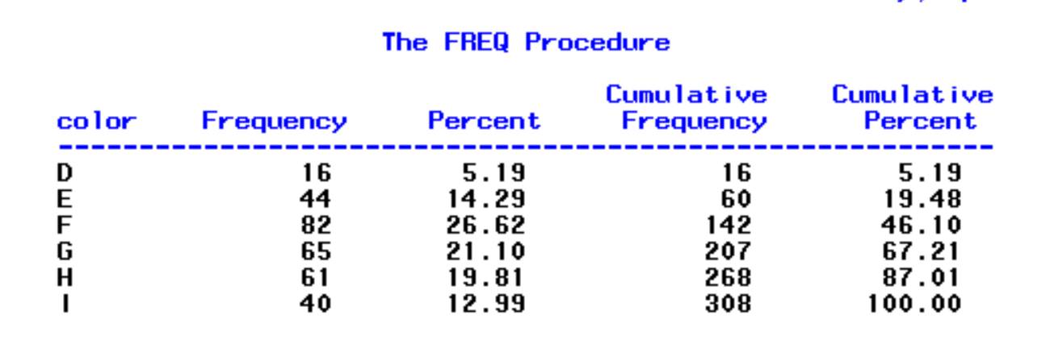
Exploratory Data Analysis
Frequency table for color

Slide 7
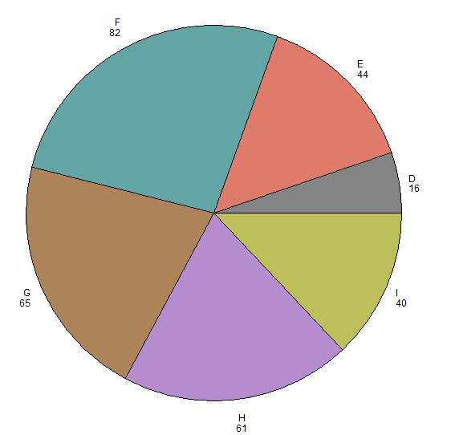
Color
Pie chart

Slide 8
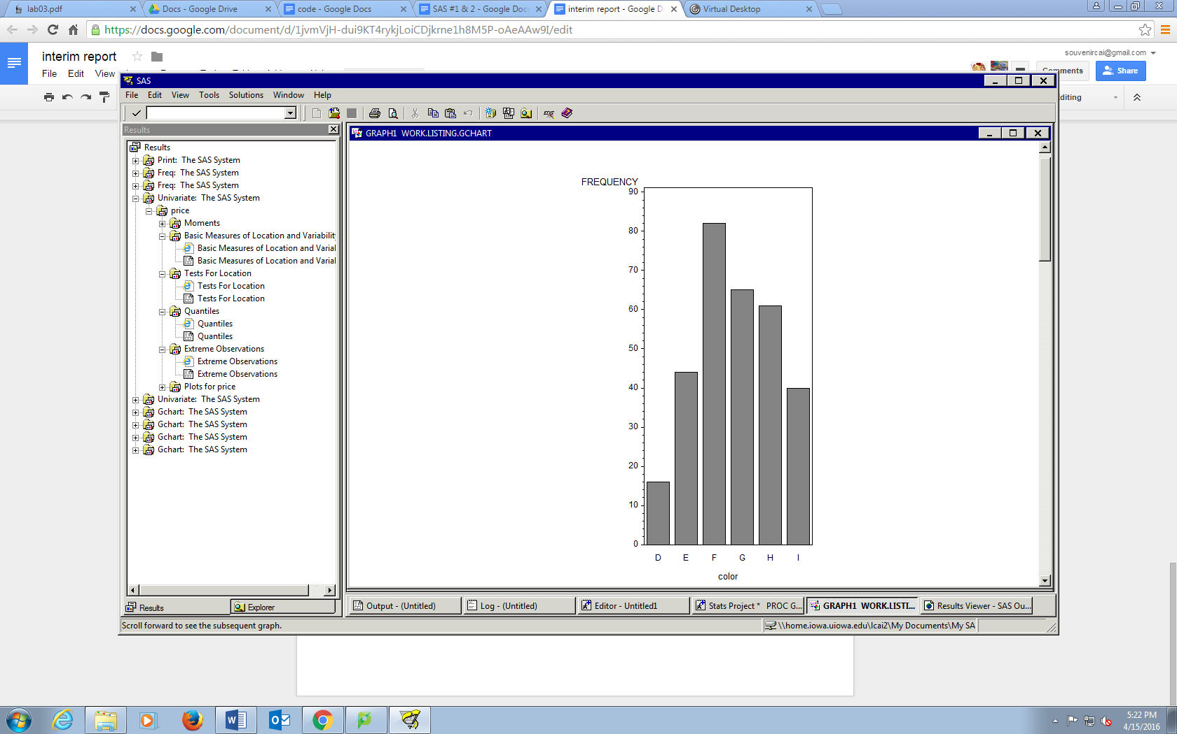
Color
Bar chart
According to the bar chart, the distribution of color is approximately symmetric.
The most frequent grade of color is grade F (26.62%), which means the grade F is the most popular color type among customers.

Slide 9
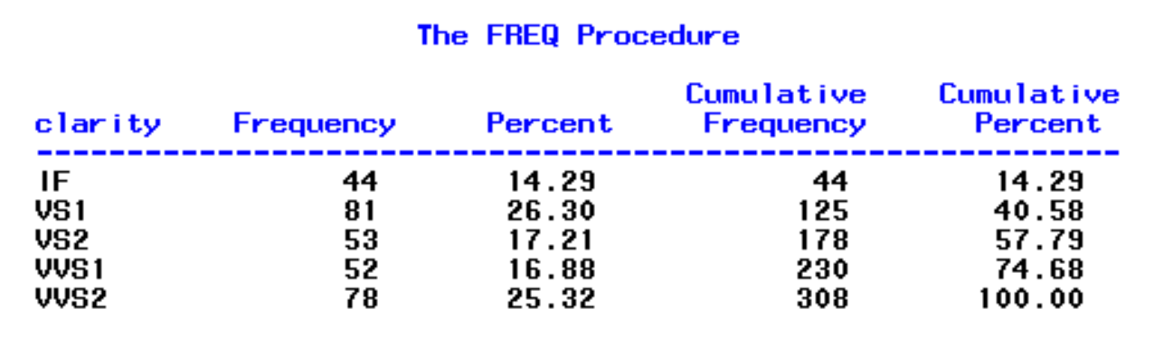
Frequency Table for Clarity

Slide 10
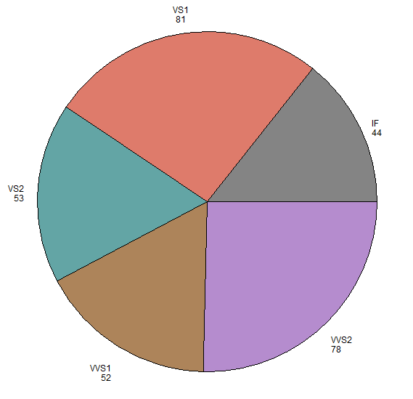
Clarity
Pie chart

Slide 11
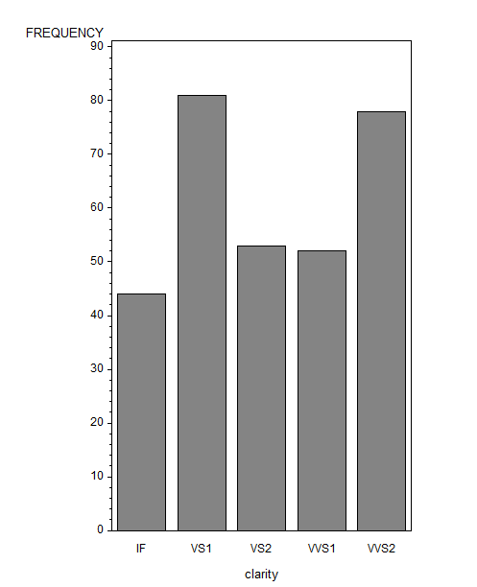
Clarity
Bar chart
The most frequent clarity are VS1 (26.3%) and VVS2 (25.32%).

Slide 12
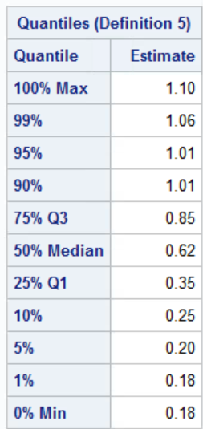
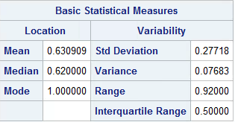
Basic Analysis of Weight

Slide 13
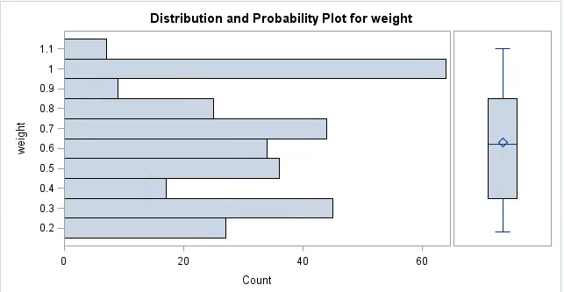
Approximately symmetric
No outlier

Slide 14
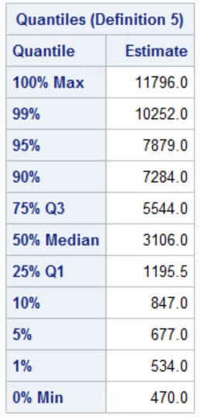
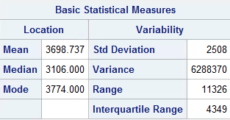
Basic Analysis of Price

Slide 15
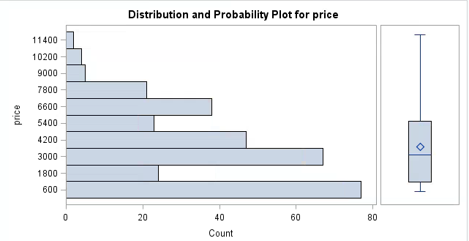
Skewed to the right
No outlier

Slide 16
Correlation Continued
➵ Positive Linear Relationship between weight and price
➵ Pearson Correlation Coefficient r = 0.94473
➵ Weight and Price are highly correlated
➵ Weight strongly influences the diamond Price

Slide 17
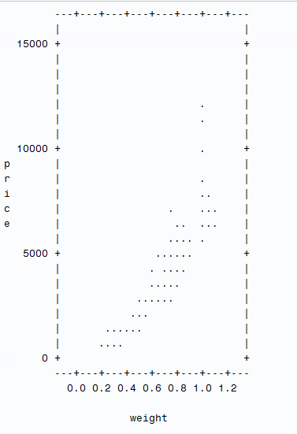
Correlation between weight and price
Pearson Correlation Coefficients, N = 308
Prob > |r| under H0: Rho=0
weight price
weight 1.00000 0.94473
<.0001
price 0.94473 1.00000
<.0001

Slide 18
Statistical Inference:
➵ How does color differ price?
Hypothesis tesing for population means of price by color
➵ How does clarity differ price?
Hypothesis testing for populations means of price by clarity
➵ How does weight influence price?
Inference for regression

Slide 19
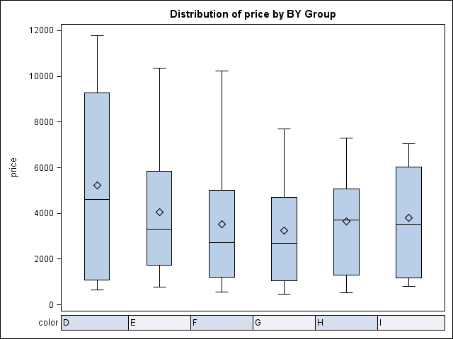
Price by Color

Slide 20
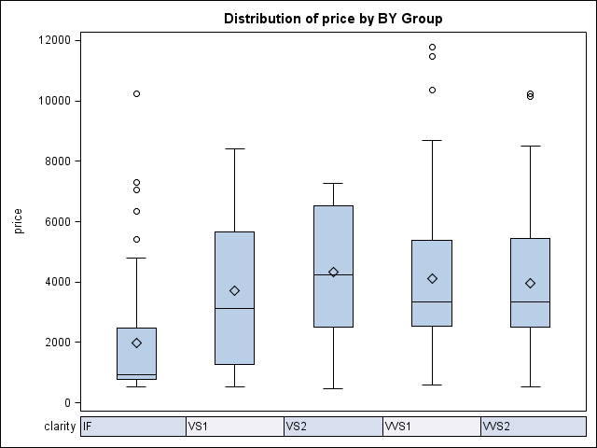
Price by Clarity

Slide 21
ANOVA Analysis: ?
According to previous two slides:
Are the means of price by color significantly different?
H0: µ_{D=}µ_{E=}µ_{F=}µ_{G=}µ_{H=}µ_{I}
Are the means of price by clarity significantly different?
H0: µ_{IF =} µ_{VS1 =} µ_{VS2 =} µ_{VVS1 =} µ_{VVS2}
We need to compare means among more than two groups:
considering ANOVA

Slide 22
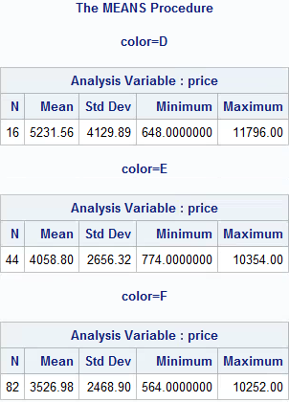
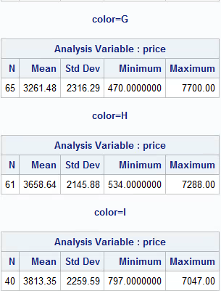
ANOVA：？(Color)

Slide 23
ANOVA (Color)：OK
Rules of Thumb:
Simple random samples: yes
Normal: not really
No outliers
large sample：>=40? ➜ ok
standard deviation
Largest = 4129.89, Smallest = 2145.88
The largest is not greater than twice smallest standard deviation ➜ ok

Slide 24
ANOVA procedure - Color & Price
We use ANOVA to see if the color significantly differs the price of diamonds. Set the hypothesis:
Ho: µ_{D} =µ_{E} =µ_{F} =µ_{G} =µ_{H} =µ_{I}
Ha: there is at least the population means of price for two colors are different

Slide 25
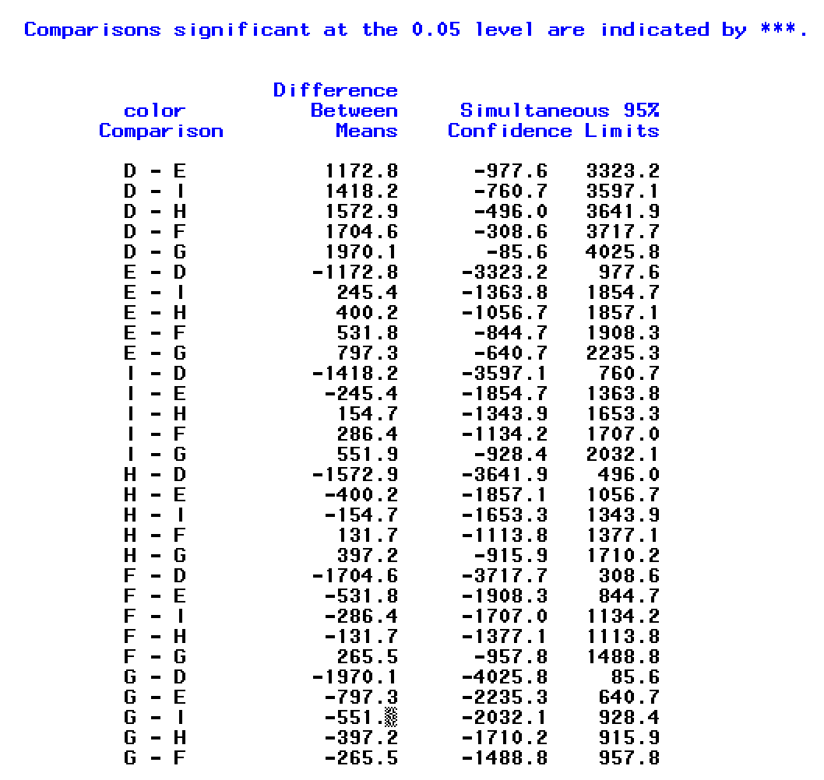

Slide 26
Summary of color
From the F test for color, F = 1.9, p = 0.0948
Not reject H₀ at significant level α = 0.05
Also based on the color comparision above, at 0.05 alpha level, there is not significant difference between any of two colors.
So we cannot get conclude that there are differences of price means between distinct colors.

Slide 27
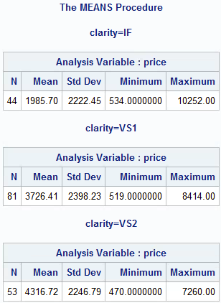
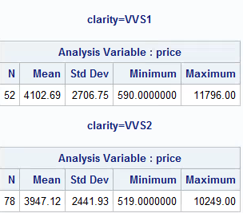
ANOVA：？(Clarity)

Slide 28
ANOVA (Clarity)：OK
Rules of Thumb:
Simple random samples: yes
Normal: not really
A few outliers
large sample：>=40? ➜ ok
standard deviation
Largest = 2706.75, Smallest = 2222.45
The largest is not greater than twice smallest standard deviation ➜ ok

Slide 29
ANOVA procedure - Clarity & Price
We use ANOVA to find whether there is difference between diamond price among different clarity
Set the hypothesis:
Ho: µ_{IF} =µ_{VS1} =µ_{VS2} =µ_{VVS1} =µ_{VVS2}
Ha: there is at least the average price for two clarties are different

Slide 30
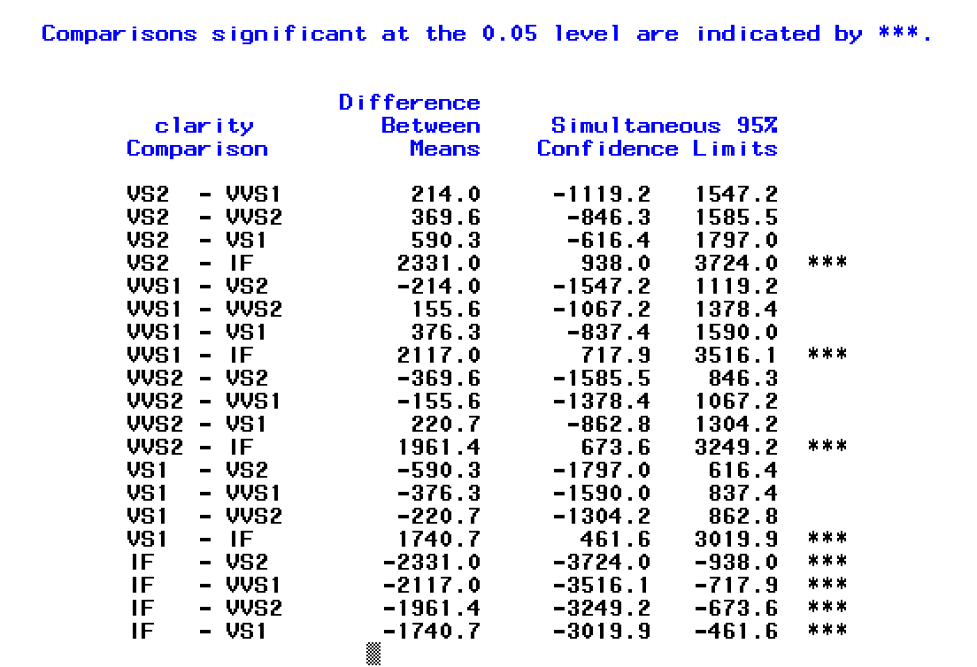

Slide 31
Summary of Clarity
From the F test for clarity, F = 6.97, p-value <0.0001, this result is a strong evidence to against Ho.
And the clarity comparision above indicates that:
IF ≠ VS1
IF ≠ VS2
IF ≠ VVS1
IF ≠ VVS2
Therefore, we can conclude that there are some difference between the price means of different clarity. And the clarity = IF is significantly different from other clarity types.

Slide 32
Inference for Regression
Review
Scatterplot of weight & price
r = 0.94473
Population regression line
µY |X=x = α + βx
Y: price, X: weight
Estimating the unknown parameters
α, β, and σ
σ is the same standard deviation of y for all values of x

Slide 33
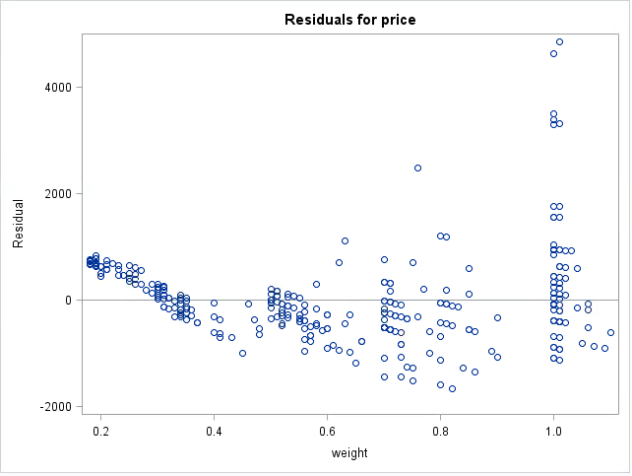
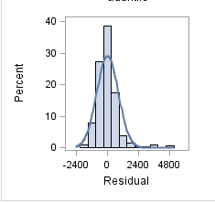
Check the conditions for Inference
Except for the outliers
Approximately Linear - Constant standard deviation
Normal residuals - No obvious pattern of dependence

Slide 34
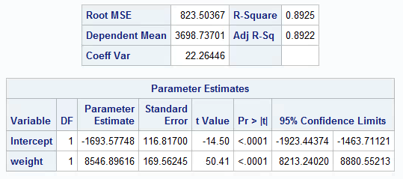
Least-squares regression line
SE_{b} = 169.56245
R² = 0.8925
89.25% of the variability in price is explained by the weight

Slide 35
Point Estimate
➵ β: The estimated slope b = 8546.89616
For a carat increase in weight, we would expect a change 8547 of dollars in price
➵ α: The estimated intercept a = - 1693.57748
You earn 1693.6 dollars if you buy zero-carat diamond
➵ σ: The sample standard deviation s_{y|x} = 823.50367
?

Slide 36
Interval estimate for slope β
point estimate = 8546.89616
SE_{b} = 169.56245
To construct a 95% confidence interval for the unknown population slope β, we need the upper .025 cutoff for a t distribution with n − 2 = 306 degrees of freedom.
This is 1.968
95% confidence interval is (8213.197258,8880.5951)
We are 95% confident that the unknown population slope β lies in this interval.

Slide 37
Testing the hypothesis of no linear relationship
We want to test if there is no linear relationship between weight and price
H₀: β = 0
H_{a} : β ≠ 0
t = b / SE_{b}
this is 50.4056
p-value is less than 0.0001
Therefore, we would have had less than 1 chance in 10,000 of obtaining sample data that produced a t statistic this far away from 0 or farther if the true population slope was 0.

Slide 38
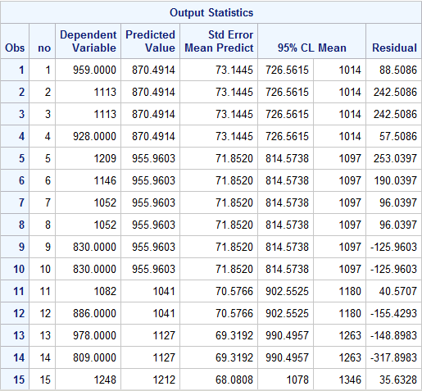
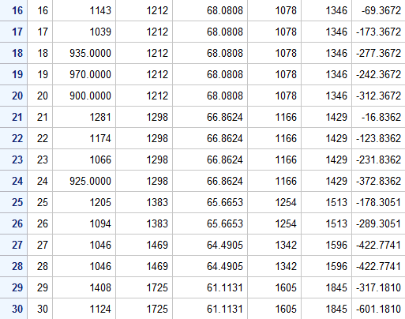
Confidence Intervals for mean price: first 30

Slide 39
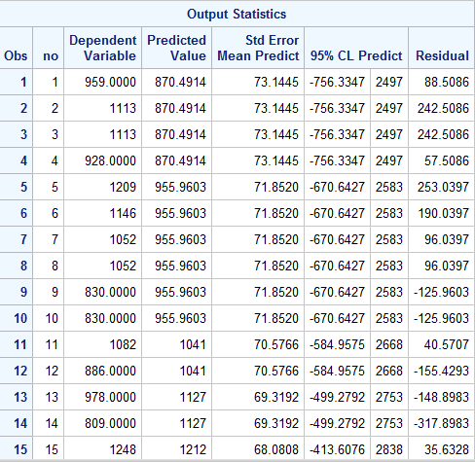
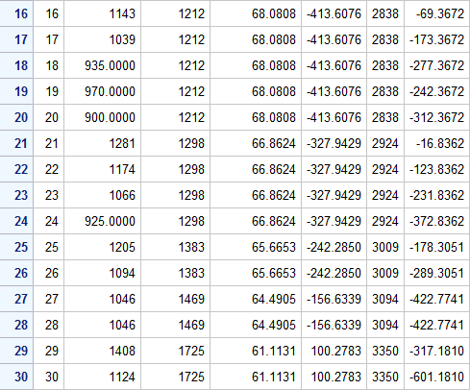
Prediction Intervals for an individual price: first 30

Slide 40
Bonus Test: Fair price?
Motivation: According to the News Report, the average price for diamond is 5000 USD per carat.
Question: Is it right for market price of diamonds?
We are going to set a hypothsis testing:
Ho: µ = 5000
Ha: µ ≠ 5000

Slide 41
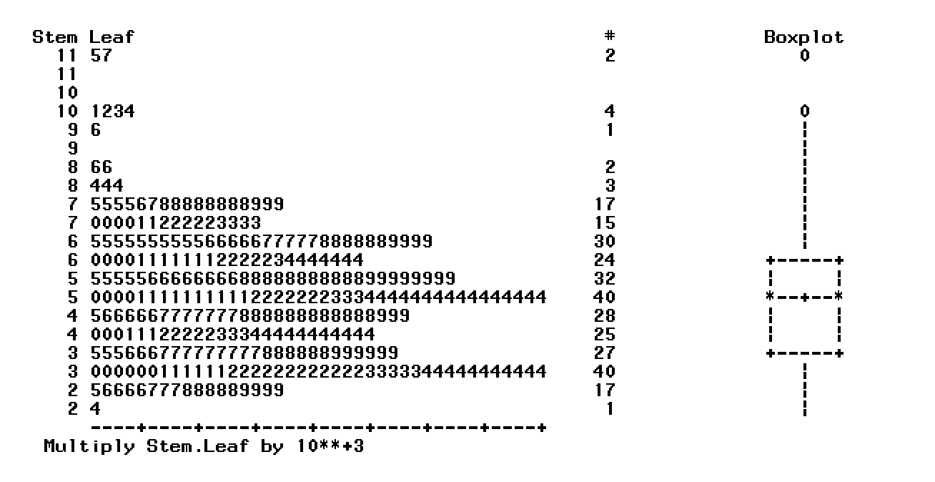
Proceed to one-sample t-test
Sample size: 308
Distribution: approximately normal
Outlier: 2 outliers

Slide 42
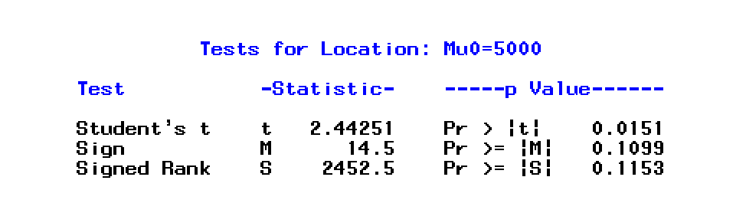
Hypothesis Testing: t test
According to the SAS output, we have p-value = 0.0151< significant level α = 0.05.
This is a strong evidence that we can reject Ho, accept Ha by saying that it is not likely the population mean price for diamonds is equal to $5000.

Slide 43
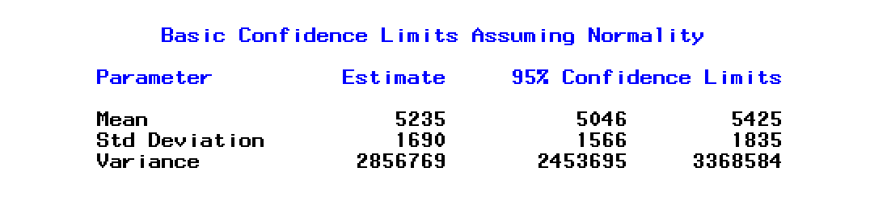
Confidence Interval
According to SAS output, we are 95% confident that the mean of diamond price per carat is between (5046, 5425) USD.

Slide 44
Conclusions
➵ The Color of diamonds does not significantly influece the Price.
➵ The Clarity of diamonds essentially differs the Price of diamonds, especially the IF scale of clarity.
➵ The Weight strongly influences the diamond Price.
Weight and Price are highly correlated.
89.25% of the variability in price is explained by the weight.
For a carat increase in weight, we would expect an increase of $8547 in price.
➵ The average price per carat is above $5000.

Slide 45
Thanks
Chu, Singfat. (2001). Pricing the C's of Diamond Stones. Journal of Statistics Education, 9(2). http://www.amstat.org/publications/jse/v9n2/4Cdata.txt
Diamondregistry. http://www.diamondregistry.com/1-carat-diamond-price.htm
Background graphic: www.pptbackgrounds.org/show/diamond.html

